Slide 1


Group 3 - ClauseGuard
Interim Presentation
A00047237 – Siddharth Varma Raja
A00047190 – Prasad Nitin Pansare
A00047193 – Shubham Tatyasaheb Patil
A00046404 – Kameshwara Karthik Ayyalasomayajula
A00046791 – Jude Fernandes
23 October 2026

Slide 2
Project Vision
WHAT
Tenancy agreements can be dense and there's always been a bit of a give and take with the laws governing tenancies in Ireland, especially the 2026 Act with its new national rent cap of either 2% or CPI. The Residential Tenancies Board (RTB) does not look at individual leases, but offers great general advice. Moreover, generic AI-powered chatbots for lease analysis can lead to harmful legal hallucinations and significant data privacy concerns for tenants.
WHO
ClauseGuard is an automated lease-compliance system which checks residential leases in line with current Irish tenancy law. It helps to simplify legal language and identify problematic clauses, clarify the problem, and suggest actionable steps. Importantly, all documents containing Personally Identifiable Information (PII) are heavily redacted before they are stored or processed.
WHY
People who are not lawyers and are living in the private rental sector in Ireland. This specifically caters to the vulnerable renters, such as domestic and international students, newly arrived expatriates and shift workers. The site is specifically geared towards empowering the tenant, not towards landlords or lawyers.

Slide 3

Project Vision

Slide 4
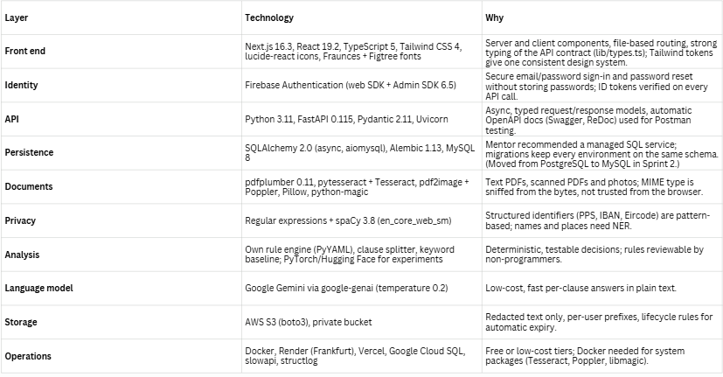
Technology Stack

Slide 5
Data Stack
Law in, leases cleaned, results out. Personal data is never stored
01
02
03
The law
Real leases
Test leases
18 Irish laws and RTB guidance, split into 27 provisions. 23 checked against RTB wording; rules stay draft until a solicitor reviews them.
289 clauses from 3 leases, labelled by hand (deposit, entry, notice...). Kept on laptops, never in the repo.
Fictional leases with planted problems, so we know what the system should find without using personal data.
What happens when a tenant uploads a lease

Slide 6
Evaluation
What we have measured so far
19/19
How we will evaluate
Frozen test set with a second annotator
Four-way comparison: keyword, zero-shot, fine-tuned, hybrid RAG
Per-class F1, false-green rate and abstention
automated software tests pass
~0.80
keyword baseline accuracy, just above always-"other" (0.78)
What it tells us
The rules are correct on the cases we tested
The model is not ready: with 289 labelled clauses it cannot beat "always other"
Next: more labelled data and a user study.
~0.40
macro-F1 score

Slide 7
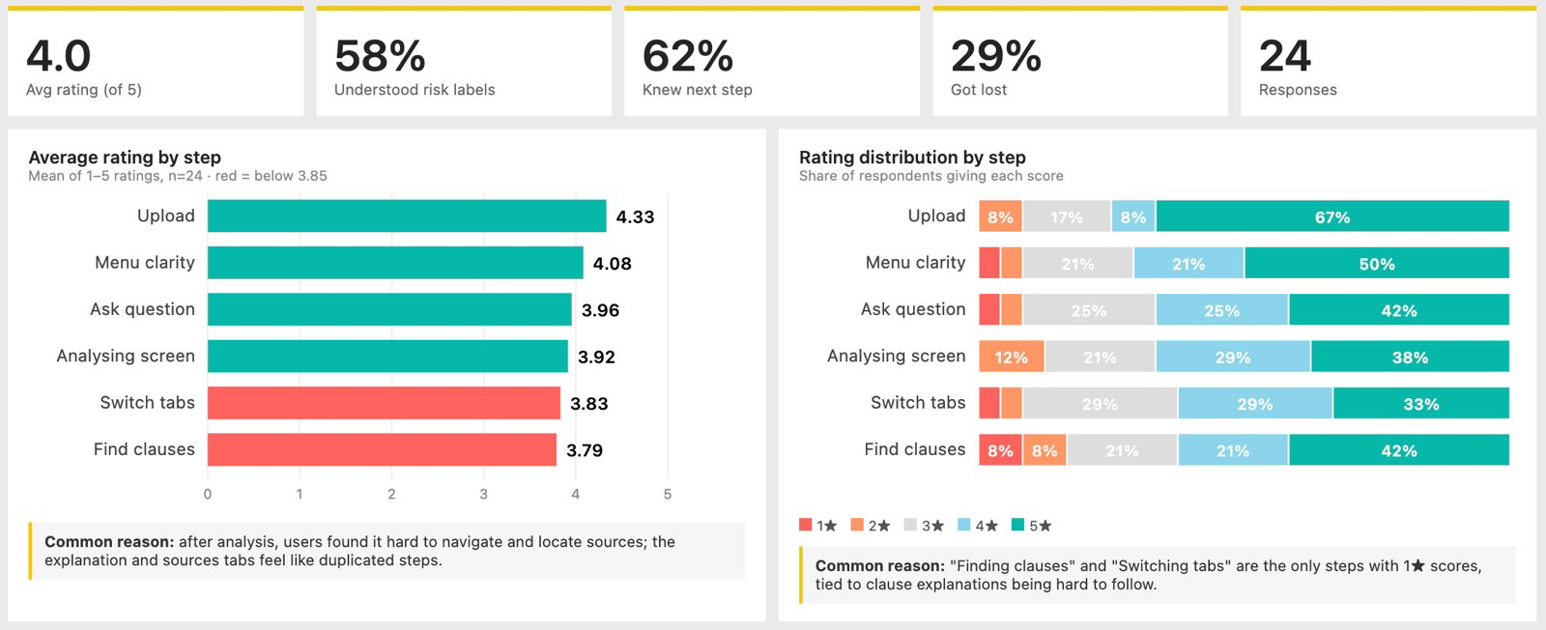
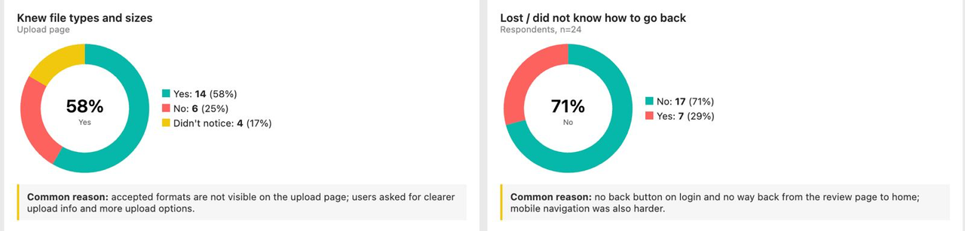
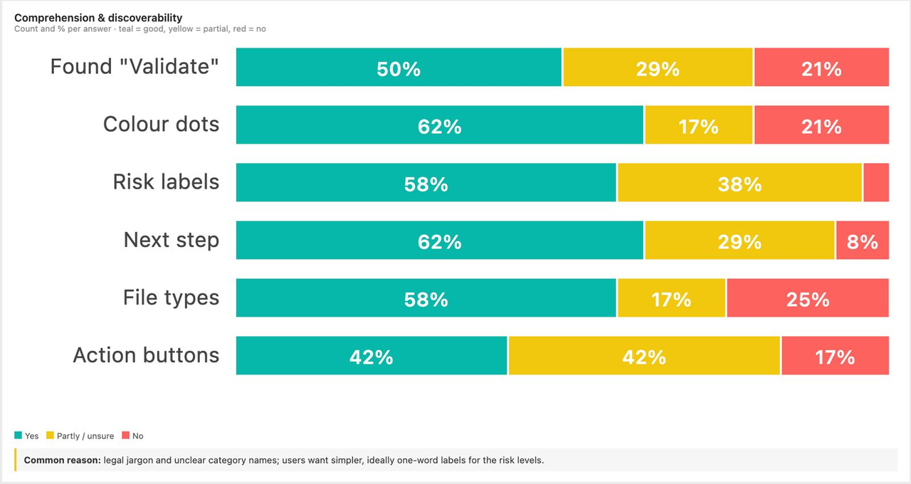
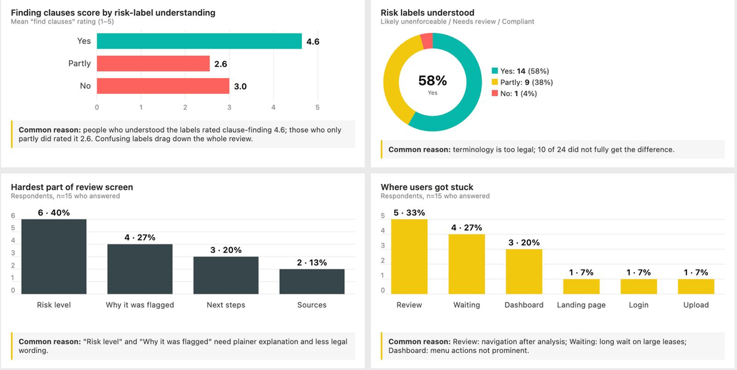
INITIAL USER EVALUATION

Slide 8










Current Prototype Demo
Application Link: clause-guard-ten-chi.vercel.app

Slide 9

Immediate Next Steps & Project Roadmap
Biggest challenge: clause analysis. Turning a real lease into real flags is not built yet, and about 289 labelled clauses cannot separate the models.
Immediate next steps
•Demo upload, review page, notice checker and chat
•Fix redaction and DOCX issues
•First user test with international students
•Literature review: accuracy, simplification, visualisation
•Start clause splitting and first rules
By 1 Nov
First end-to-end slice: real lease to real flags with citations
By 15 Nov
add rules and topic traffic lights, second user round
29–30 Nov
Full evaluation of four approaches, feature freeze, solicitor check
To 13 Dec
Hardening, testing, deployment, final report and presentation

Slide 10


THANK YOU

